Slide 1

Attachment K: JDA Software Architecture

Slide 2

The JDA PortfolioTM Framework
The PortfolioTM Business Registry
The PortfolioTM Platform Registry
PortfolioTM Registry Adapters
The PortfolioTM Desktop Environment
PortfolioTM Desktop Adapters
PortfolioTM Business Services
PortfolioTM Collaboration Services
PortfolioTM Synchronized Release

Slide 3
The JDA PortfolioTM Framework
The PortfolioTM Business Registry
The PortfolioTM Platform Registry
PortfolioTM Registry Adapters
The PortfolioTM Desktop Environment
PortfolioTM Desktop Adapters
PortfolioTM Business Services
PortfolioTM Collaboration Services
PortfolioTM Synchronized Release

Slide 4
Shared Data Model
Application Data
Floor Plan
Plan-a-Grams
Etc.
Merchandising
Merchandising
Merchandising
Planning
Planning
Analytics
Core Enterprise Data
Product Catalog
Org Structure
Calendar

Slide 5
The PortfolioTM Business Registry
Analytics
Promotions
Replenishment
Planning
Customer
Store Systems
Merchandising
PortfolioTM Business Registry
PortfolioTM Business Registry

Slide 6
The PortfolioTM Business Registry
Analytics
Promotions
Replenishment
Merchandising
Planning
Customer
Store Systems
PortfolioTM Business Registry

Slide 7
The JDA PortfolioTM Framework
The PortfolioTM Business Registry
The PortfolioTM Platform Registry
PortfolioTM Registry Adapters
The PortfolioTM Desktop Environment
PortfolioTM Desktop Adapters
PortfolioTM Business Services
PortfolioTM Collaboration Services
PortfolioTM Synchronized Release

Slide 8
The PortfolioTM Platform Registry
Share Enterprise Data for Platform
  User
  Personalization
  Security
  Authentication
  Configuration
  Language
  Application Health
Relational or LDAP Data Storage
Supports Open Standard Interfaces
  WSI Security
  Kerberos

Slide 9
The JDA PortfolioTM Framework
The PortfolioTM Business Registry
The PortfolioTM Platform Registry
PortfolioTM Registry Adapters
The PortfolioTM Desktop Environment
PortfolioTM Desktop Adapters
PortfolioTM Business Services
PortfolioTM Collaboration Services

Slide 10
The Portfolio Desktop Environment
A Role Based View Into Enterprise Information Systems
  Focused on the job being performed not on the architecture of the system
  Provides personalization of the presentation of information
  Common look & feel across different information systems
  Deployed via Right Sized deployment model
Notes:
What is a Portal? Lots of companies talk about being portal providers. It’s a very popular buzz word in the media today. Yahoo describes themselves as an Internet Portal, Amazon describes themselves as a shopping portal, there are companies that focus just on providing information portals or digital desktops. What JDA describes as a portal has three primary characteristics:
Its role based. For the past decade or longer, user interfaces were designed focused on the functionality of the system. The menus and navigation through the system matched the functional structure of the system. They had inventory menus, general ledger menus, purchasing menus, etc. But often times in order for a person to perform their job they needed to access functionality from numerous functional areas. For example, a buyer might need to look at the current on hand inventory position in the inventory system, the open to buy plan in the planning system, the sales performance in the performance analysis system, and execute the purchasing transaction in the purchasing system. This meant that the buyer need to think about how to use the tool in order to accomplish their job. With a role based user interface, the UI is designed around the job being performed so that the user doesn’t have to think about how to use the tool. They can focus on thinking about how to do their job. We call this a frictionless user interface.
The second primary characteristic of a JDA portal is that it provides a common view across the entire JDA application suite. JDA has a broad suite of industry leading applications. We have the most broadly installed merchandising systems with MMS and ODBMS in use in over 400 large chain retailers. We have the market leading planning system with Arthur capturing 80%+ of the financial and assortment planning market. We have the market leading plan-o-gramming and space planning system with Intactix capturing 80%+ of the space planning market. In each case we have products that provide the most robust, high performance, retail functionality available in the market. JDA has put a lot of effort into integrating these systems in the back end so that they exchange data and services with each other. We spend millions of dollars each year enhancing these interfaces to make these products work well with each other. But each of these products was written by different people, at different times, in different languages, different databases, different operating systems, and different look & feel. So when users would work with the products they perceived the products as being poorly integrated. Portals allows us to bring together these very high functional, integrated data and services into a common look and feel that gives the user a single environment to work in across all of the JDA products.
Finally, the third primary characteristic of a JDA portal is that it is deployed over the web or over a wide area network. This means that you don’t have to touch each desk top in order to install and maintain the portal software. You simply maintain the system on a centrally managed application server and then access the portal through a standard web browser. We work with both Internet Explorer and Netscape Navigator, basically any browser that supports ActiveX controls and DHTML. This results in a significant reduction in the Total Cost of Ownership (TCO) of the system and allows retailers to enhance and improve their systems more rapidly and with lower risk.

Slide 11
User Interface Framework
Common Set of User Interface Components
  Banner
  Actions
  Navigator
  Work Area
  Desktop Adapters
  Alerts
Language, Date, & Time Formats
Navigational Security

Slide 12
PortfolioTM Desktop Adapters
Granular User Interface Components
Multi-Mode Thin/Thick Client Support
  Web Components
  Win Components
  Win via Web Components
  Supports Right Sized Deployment of Business Processes
Personalization via PortfolioTM Platform Registry
  Desktop Adapter Catalog
  Work Area Templates

Slide 13
.NET strategy
Application
Service
Message Switch
ODBMS
Win 2000
BizTalk
Object to Relational Map
Transportation
Stored
Procs
POMHDR
Encryption
POMITM
Business Entity
Authentication
POMNOT
Session Entity
Transformation
ASP
SOAP Service

Slide 14
The JDA PortfolioTM Framework
The PortfolioTM Business Registry
The PortfolioTM Platform Registry
PortfolioTM Registry Adapters
The PortfolioTM Desktop Environment
PortfolioTM Desktop Adapters
PortfolioTM Business Services
PortfolioTM Collaboration Services
PortfolioTM Synchronized Release

Slide 15




The Portfolio Information Pipeline
Step 2
Step 1
Step 4
Step 5
Step 3
Information Pipe
TCP/IP, HTTP, XML, DHTML, SOAP, WSDL, WSML, UDDI, etc
Adapter
Adapter
Adapter
Adapter
Adapter

Slide 16
PortfolioTM Registry Adapters
High performance JDA application adapters
  Query Optimization
  Connection Pooling
  Message Queuing
  Data Ranging & Filtering
  Multi-Threaded/Clustering

Slide 17
The Web Services Environment
Environment Services
  Messaging
  Routing
  Non-Repudiation
  Transformation
  Encryption
  Authentication
  Transportation
  Transaction Control
  Deployment
  Common Development Tools
Provided by the Microsoft .Net Environment

Slide 18
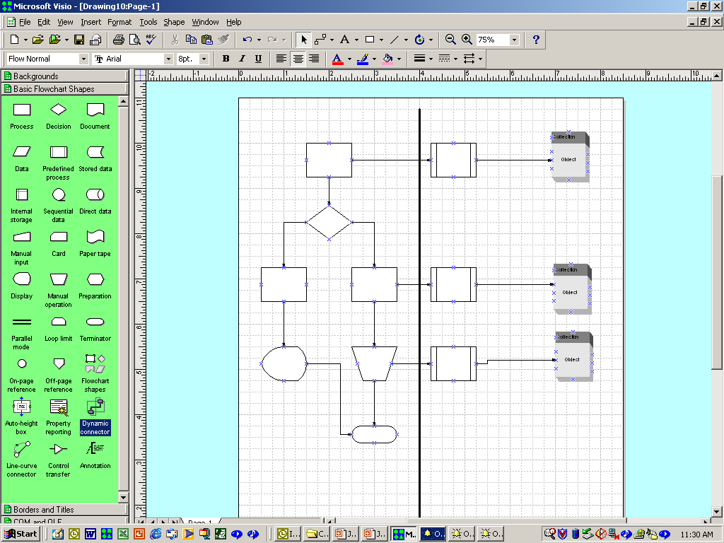
Work Flow Management
Profile Management
  Personalization
  Authentication
  Security
Task Management
  Task Based UI
  Workflow Navigation
  Alerting & Escalation
Business Process Management
  Workflow Engine
  Designer
  Analytics

Slide 19
PortfolioTM Collaboration Service
Framework Components Based On Open Architecture
  PortfolioTM Enabled Applications Plug Directly Into Framework
    JDA Provided
    Partner Provided
  Simplifies Integration with non-PortfolioTM Enabled Applications
    Adapter Template SDKs
    Open Standards Based
    Embed other applications in PortfolioTM Framework
    Embed PortfolioTM Enabled Applications within other EAI/Portal Tools

Slide 20
The JDA PortfolioTM Framework
The PortfolioTM Business Registry
The PortfolioTM Platform Registry
PortfolioTM Registry Adapters
The PortfolioTM Desktop Environment
PortfolioTM Desktop Adapters
PortfolioTM Business Services
PortfolioTM Collaboration Services
PortfolioTM Synchronized Release

